Slide 1

Hierarchical Clustering

Slide 2
Hierarchical Clustering
Hierarchical clustering is an alternative approach to partitioning clustering for grouping objects based on their similarity.
In contrast to partitioning clustering, hierarchical clustering does not require to pre-specify the number of clusters to be produced.

Slide 3
Hierarchical Clustering
Hierarchical clustering can be subdivided into two types:
Agglomerative clustering.
Divisive clustering.
The result of hierarchical clustering is a tree-based representation of the objects, which is also known as a dendrogram.

Slide 4
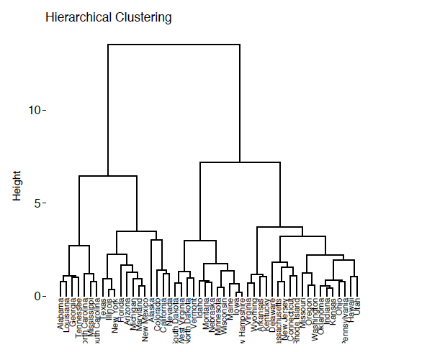
Hierarchical Clustering

Slide 5
Agglomerative Clustering
This is clustering where each observation is initially considered as a cluster of its own (leaf) before the most similar clusters are successively merged until there is just one single big cluster(root).

Slide 6
Divisive Clustering
This is clustering begins with the root, in which all objects are included in one cluster. Then the most heterogeneous clusters are successively divided until all observations are in their own cluster.

Slide 7
Agglomerative Clustering
This is agglomerative clustering is also known as agglomerative Nesting (AGNES).
The algorithm starts by treating each object as a singleton cluster.
Next pairs of clusters are successively merged until all clusters have been merged into one big cluster containing all objects.

Slide 8
Agglomerative Clustering Algorithm
This is agglomerative clustering works in a “bottom-up” manner.
Each object is considered as a single-cluster element (leaf)
Agglomerative clustering is good at identifying small clusters.
The inverse of agglomerative clustering is divisive clustering, which is also known as DIANA (Divise Analysis) and it works in a “top-down” manner. It begins with the root, in which all objects are included in a single cluster. At each step of iteration, the most heterogeneous cluster is divided into two.

Slide 9
Agglomerative Clustering Algorithm
Preparing the data.
Computing (dis) similarity information between every pair of objects in the data set.
Using linkage function to group objects into hierarchical cluster tree, based on the distance information generated at step 1. Objects/clusters that are in close proximity are linked together using the linkage function.

Slide 10
Agglomerative Clustering Algorithm
4. Determining where to cut the hierarchical tree into clusters. This creates a partition of the data.

Slide 11
Key points
The data should be a numeric matrix.
Linkage: This takes the distance information, and groups pairs of objects into clusters based on their similarity.
Newly formed clusters are linked iteratively until all objects in the data set are linked together in a tree.

Slide 12
Agglomeration (linkage) methods
There are many cluster agglomeration methods (i.e., linkage methods). The most common linkage methods are described below:
Maximum or complete linkage: The distance between two clusters is defined as the maximum value of all pairwise distances between the elements in cluster 1 and the elements in cluster 2. It tends to produce more compact clusters.

Slide 13
Agglomeration (linkage) methods
Minimum or single linkage: The distance between two clusters is defined as the minimum value of all pairwise distances between the elements in cluster 1 and the elements in cluster 2. It tends to produce long, "loose" clusters.
Mean or average linkage: The distance between two clusters is defined as the average distance between the elements in cluster 1 and the elements in cluster 2.

Slide 14
Agglomeration (linkage) methods
Centroid linkage: The distance between two clusters is defined as the distance between the centroid for cluster 1 (a mean vector of length p variables) and the centroid for cluster 2.
Ward’s minimum variance method: It minimizes the total within-cluster variance. At each step the pair of clusters with minimum between-cluster distance are merged.

Slide 15
Agglomeration (linkage) methods
Note that, at each stage of the clustering process the two clusters, that have the smallest linkage distance, are linked together.
Complete linkage and Ward’s method are generally preferred.

Slide 16
Dendrogram
Dendrograms correspond to the graphical representation of the hierarchical tree.
The height of the fusion, provided on the vertical axis, indicates the (dis)similarity/distance between two objects/clusters. The higher the height of the fusion, the less similar the objects are. This height is known as the cophenetic distance between the two objects.

Slide 17
Dendrogram

Slide 18
Verify the cluster tree
After linking the objects in a data set into a hierarchical cluster tree, you might want to assess that the distances (i.e., heights) in the tree reflect the original distances accurately.
One way to do this is to compute the correlation between the cophenetic distances and the distances in the distance matrix.

Slide 19
Verify the cluster tree
If the clustering is valid, the linking of objects in the cluster tree should have a strong correlation with the distances between objects in the original distance matrix.
The closer the value of the correlation coefficient is to 1, the more accurately the clustering solution reflects your data. Values above 0.75 are felt to be good.

Slide 20
Cut the dendrogram into different groups
One of the problems with hierarchical clustering is that, it does not tell us how many clusters there are, or where to cut the dendrogram to form clusters.
You can cut the hierarchical tree at a given height in order to partition your data into clusters.

Slide 21
Cut the dendrogram into different groups
One of the problems with hierarchical clustering is that, it does not tell us how many clusters there are, or where to cut the dendrogram to form clusters.
You can cut the hierarchical tree at a given height in order to partition your data into clusters.

Slide 22
Agglomerative Clustering in R
To perform hierarchical cluster analysis in R, the first step is to calculate the pairwise distance matrix using the function dist(). Next, the result of this computation is used by the hclust() function to produce the hierarchical tree.
You can use the function fviz_dend() [in factoextra R package] to plot easily a beautiful dendrogram.

Slide 23
Agglomerative Clustering in R
The cophenetic() function in R is used to compute the cophenetic distances.
The agnes() and diana() functions [in cluster package] can be used for the agglomerative and divisive clustering, respectively.

Slide 24
Application of hierarchical clustering to gene expression data analysis.
In gene expression data analysis, clustering is generally used as one of the first step to explore the data. We are interested in whether there are groups of genes or groups of samples that have similar gene expression patterns.
For most common clustering software, the default distance measure is the Euclidean distance. The most popular methods for gene expression data are to use log2 (expression+ 0.25), correlation distance and complete linkage clustering agglomerative-clustering.

Slide 25
Application of hierarchical clustering to gene expression data analysis.
In gene expression data analysis, clustering is generally used as one of the first step to explore the data. We are interested in whether there are groups of genes or groups of samples that have similar gene expression patterns.
For most common clustering software, the default distance measure is the Euclidean distance. The most popular methods for gene expression data are to use log2 (expression+ 0.25), correlation distance and complete linkage clustering agglomerative-clustering.

Slide 26
Summary
Hierarchical clustering is a cluster analysis method, which produce a tree-based representation (i.e.: dendrogram) of a data. Objects in the dendrogram are linked together based on their similarity.
To perform hierarchical cluster analysis in R, the first step is to calculate the pairwise distance matrix using the function dist(). Next, the result of this computation is used by the hclust() function to produce the hierarchical tree.

Slide 27
Summary
Finally, you can use the function fviz_dend() [in factoextra R package] to plot easily a beautiful dendrogram.
It’s also possible to cut the tree at a given height for partitioning the data into multiple groups (R function cutree()).

